Slide 1
Atomic Structure
From Bohr to Quantum
Richard Lasky – Summer 2010

Slide 2
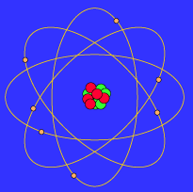
Models of Atoms
Nobody has ever seen the actual atomic structure of an atom but the early planetary model suggested by Niels Bohr in 1913 is the one always shown in popular literature
Bohr Model of Atom

Slide 3
Models of Atoms
Today’s model of the atom is mathematical
It is consistent with a model for light

Slide 4
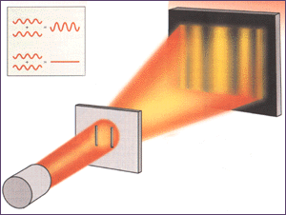
Nature of Light
All light has its source in the motion of electrons
Isaac Newton thought that light was a particle
Christian Huygens thought it was a wave
Thomas Young demonstrated interference
So Maxwell and Hertz said this “proved” it was a wave

Slide 5
Albert Einstein solves the problem
In 1905 showed a view of light as having tiny particles that were concentrated bundles of energy
Einstein built on the work of Max Planck who had suggested that when an atom emits light the energy of the atom changes by quantum amounts – discrete jumps – not continuous
He proposed that light is composed of quanta which are called photons
So light has a dual nature – particle and wave

Slide 6
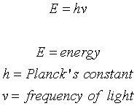
The photoelectric effect
Photons have no rest mass
The energy of a photon if proportional to its frequency
Einstein came up with his theory by noticing that certain materials eject an electron when light falls upon them – this is called the photoelectric effect
But an electron is not ejected until the light energy reaches a certain level

Slide 7
The new model of the atom
DeBroglie in 1924 proposed that if light can have particle properties then particles could have wave properties
All particles – electrons, protons, atoms, molecules and even humans a wavelength
It is related to the momentum of the particles
λ = wavelength, h = Planck’s constant, p = momentum
Remember momentun, p = m(mass) x v(velocity)

Slide 8
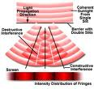
Double slit experiement
Demonstrates the dual nature of particles
Was first performed by Thomas Young in 1801 to demonstrate interference patterns of light – was used to “prove” the wave theory of light
Clauss Jonsson performed in 1961 with electrons to demonstrate the dual nature of particles
http://www.youtube.com/watch?v=DfPeprQ7oGc

Slide 9
Quantum model of atom
The atom consists of particles that exist in discrete energy states(quanta) and move in wavelike fashion
We only know where a particle might be, not exactly where it is
This is determined by the use of very sophisticated probability calculations – quantum mechanics

Slide 10
Quantum Mechanics
In the 1920’s a lot of work was completed in Quantum mechanics
Some important concepts from Quantum Mechanics are:
Heisenberg uncertianty principle
Pauli exclusion principle
Schroedinger equations

Slide 11
Heisenberg uncertainty principle
Results from the wave-particle duality
States that the position and the momentum of a particle cannot be measured precisely at the same time
And, the product of the uncertainties must be greater than or equal to h/2∏
http://www.youtube.com/watch?v=KT7xJ0tjB4A

Slide 12
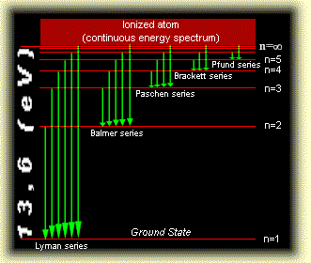
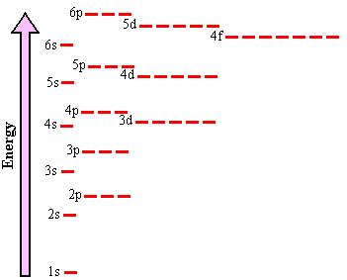
Pauli exclusion principle
No two electrons can occupy the same quantum state
This leads to the electrons being grouped into shells and subshells
Relative Energies of Atomic Orbitals

Slide 13
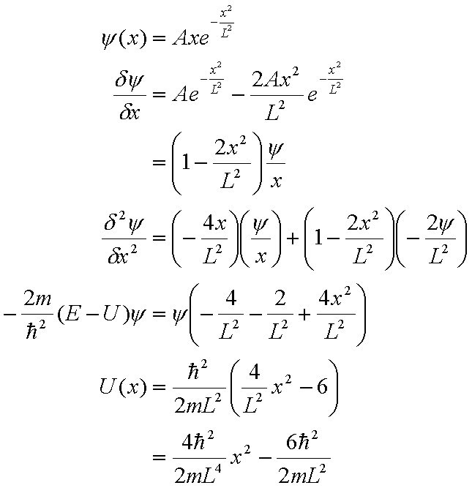
Schroedinger equations
Equations for the calculation of the probability of the future behavior of a dynamic system
Detailed outcome is not strictly determined, but given a large number of events, the Schrodinger equation will predict the distribution of results
http://www.youtube.com/watch?v=CrxqTtiWxs4
Schroedinger’s Cat---

Slide 14
Summary of Quantum Mechanics
http://www.youtube.com/watch?v=45KGS1Ro-sc&feature=related

